Slide 1


SQL
NIT ASSIGNMENT-7
FROM: KILLI RAMA KRISHNA

Slide 2
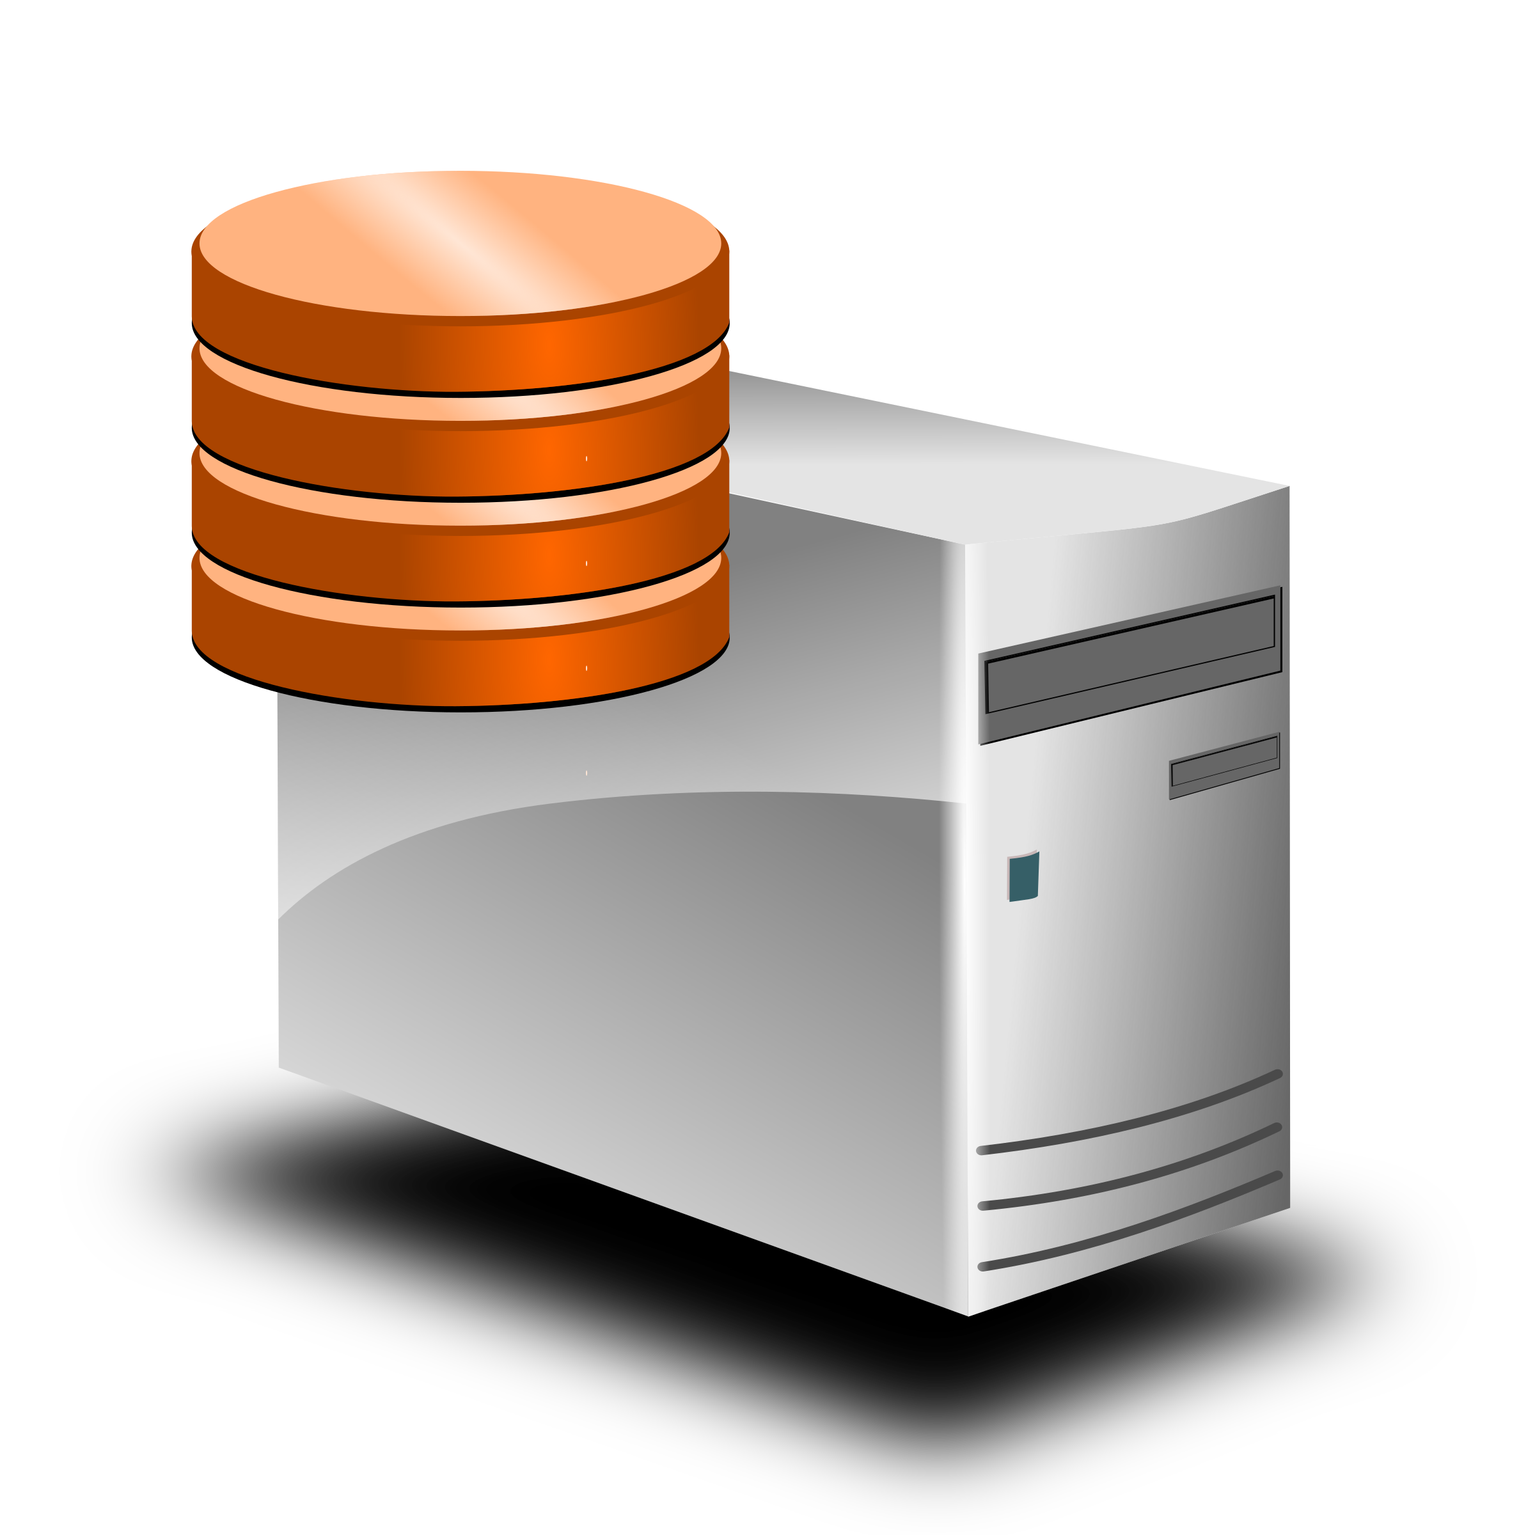

DBMS
What is DBMS?
Database Management System (DBMS) is a software used for the storage, access and manipulation of data. Along with this, DBMS helps in securing data and getting useful insights from it. Common DBMS software are MySQL, PostgreSQL, Microsoft Access, MariaDB, SQLite and Microsoft SQL Server.
Advantages of DBMS:
DBMS helps in standardizing processes, thus ensuring uniformity in data structures.
DBMS optimizes the needs of applications and helps users to accordingly retrieve, access and alter data.
In DBMS, you can provide access to different users based on their roles. DBMS also has a concept called views which enables different users to obtain a different view of the table with different features.
DBMS uses normalization which is a process used for this purpose. It splits relations (tables) whose attributes cause redundancy.
DBMS allows multi-user transaction processing which means that users can access data in parallel and manipulate it without causing concurrency issues.
It provides backup and recovery features that help create an automatic backup of data in a timely manner. This helps in mitigating unexpected hardware and software failures.
Due to the centralized nature of a DBMS, it can be easily maintained, thus saving time for development and maintenance.
Queries in DBMS are easy to learn and the different software that are used for this purpose are very easy to use.

Slide 3
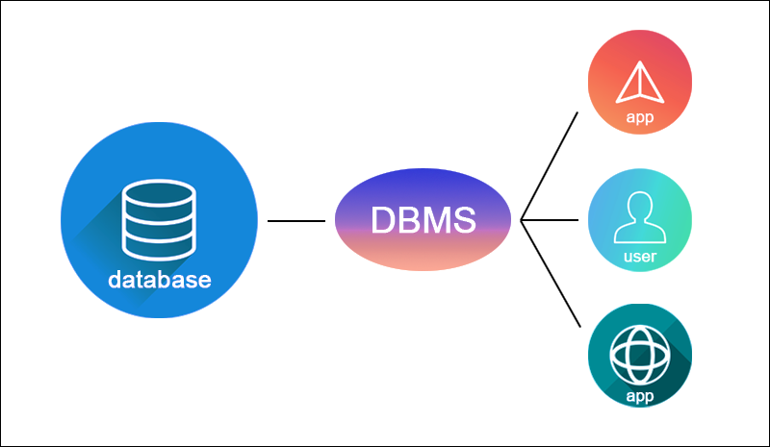

Slide 4
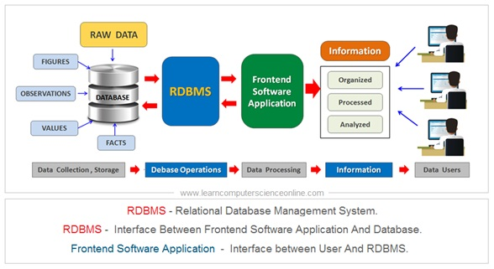
RDBMS
What is RDBMS?
RDBMS stands for Relational Database Management System.
RDBMS is a program used to maintain a between tables.
RDBMS is the basis for all modern database systems such as MySQL, Microsoft SQL Server, Oracle, and Microsoft Access.
RDBMS uses SQL queries to access the data in the database.
What is a Database Table?
A table is a collection of related data entries, and it consists of columns and rows.
A column holds specific information about every record in the table.
A record (or row) is each individual entry that exists in a table.
Look at a selection from the Northwind "Customers" table:
What is a Relational Database?
A relational database defines database relationships in the form of tables. The tables are related to each other - based on data common to each.

Slide 5
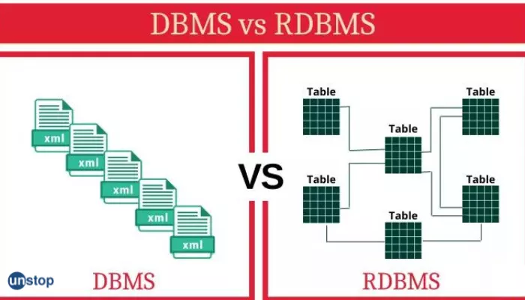

Slide 6
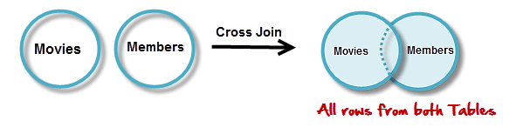
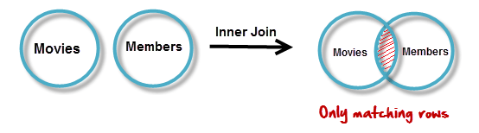
What are JOINS?
Joins help retrieving data from two or more database tables.
The tables are mutually related using primary and foreign keys.
Note: JOIN is the most misunderstood topic amongst SQL leaners. For sake of simplicity and ease of understanding , we will be using a new Database to practice sample.
Types of joins:
Cross JOIN
INNER JOIN
Outer JOINs
LEFT JOIN
RIGHT JOIN
Cross JOIN:
Cross JOIN is a simplest form of JOINs which matches each row from one database table to all rows of another. In other words it gives us combinations of each row of first table with all records in second table. Suppose we want to get all member records against all the movie records, we can use the script shown below to get our desired results.
Example:
SELECT * FROM `movies` CROSS JOIN `members`
2.INNER JOIN:
The inner JOIN is used to return rows from both tables that satisfy the given condition.
Suppose , you want to get list of members who have rented movies together with titles of movies rented by them. You can simply use an INNER JOIN for that, which returns rows from both tables that satisfy with given conditions.
Example:
SELECT A.`first_name` , A.`last_name` , B.`title`
FROM `members`AS A
INNER JOIN `movies` AS B
ON B.`id` = A.`movie_id`

Slide 7
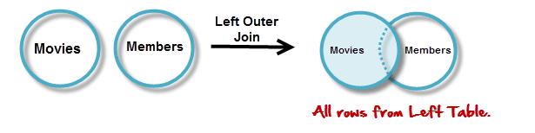
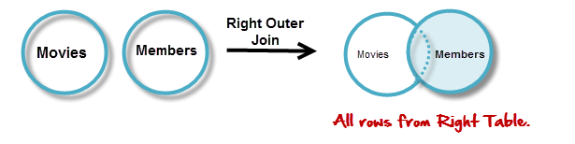
Outer JOINs:
MySQL Outer JOINs return all records matching from both tables .
It can detect records having no match in joined table. It returns NULL values for records of joined table if no match is found.
2.LEFT JOIN:
The LEFT JOIN returns all the rows from the table on the left even if no matching rows have been found in the table on the right. Where no matches have been found in the table on the right, NULL is returned.
Example:
SELECT A.`title` , B.`first_name` , B.`last_name`
FROM `movies` AS A
LEFT JOIN `members` AS B
ON B.`movie_id` = A.`id`
3.RIGHT JOIN:
RIGHT JOIN is obviously the opposite of LEFT JOIN. The RIGHT JOIN returns all the columns from the table on the right even if no matching rows have been found in the table on the left. Where no matches have been found in the table on the left, NULL is returned.
Example:
SELECT A.`first_name` , A.`last_name`, B.`title`
FROM `members` AS A
RIGHT JOIN `movies` AS B
ON B.`id` = A.`movie_id`

Slide 8


Slide 9


Sub query vs joins
Almost all SELECT statements that join tables and use the join operator can be rewritten as subqueries, and vice versa. Writing the SELECT statement using the join operator is often easier to read and understand and can also help the SQL Server Database Engine to find a more efficient strategy for retrieving the appropriate data. However, there are a few problems that can be easier solved using subqueries, and there are others that can be easier solved using joins.
Subquery Advantages:
Subqueries are advantageous over joins when you have to calculate an aggregate value on-the-fly and use it in the outer query for comparison.
Example:
Disadvantage:
This problem cannot be solved easily with a join, because you would have to write the aggregate function in the WHERE clause, which is not allowed. (You can solve the problem using two separate queries in relation to the works_on table.)
Joins Advantage:
Joins are advantageous over subqueries if the SELECT list in a query contains columns from more than one table.
Example 2:

Slide 10
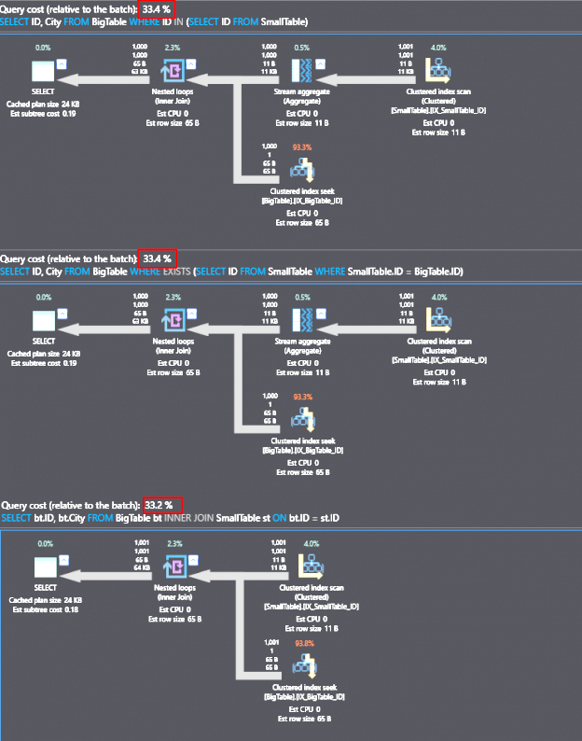

Slide 11

There are a few things you can do to improve the performance of retrieving data from 10 to 12 tables which are interconnected with constraints.
Use indexes. Indexes can help the database find the data you need more quickly.
Use joins efficiently. There are different types of joins, and some are more efficient than others. For example, an inner join is more efficient than a cross join.
Use a database that is designed for performance. Some databases, such as MySQL and PostgreSQL, are designed for performance. Others, such as Oracle and Microsoft SQL Server, are designed for scalability.
Use a caching solution. A caching solution can store frequently accessed data in memory, which can improve performance.
In addition to these general tips, there are also a few things you can do specifically for projects that involve retrieving data from 10 to 12 tables.
Plan your queries carefully. Before you start writing queries, take some time to plan them out. This will help you identify the most efficient way to retrieve the data you need.
Use stored procedures. Stored procedures can help you improve performance by grouping together multiple queries and executing them as a single unit.
Use a sharding solution. If you have a large amount of data, you may want to consider using a shading solution. Sharding divides the data into multiple smaller pieces, which can improve performance by distributing the load across multiple servers.

Slide 12


Slide 13

THANK YOU

